Slide 1


ENGINEERING CAPSTONE PROJECT – 1/INDUSTRIAL INTERNSHIP/ INDUSTRIAL INTERNSHIP PHASE-I
Project Review-2
An Extensible Personal Finance Management Framework for Expense Tracking, Visual Analytics, and Intelligent Decision Support
Team No- 9
2320030368 – Sneha Mithra
Under the Guidance of
Dr. K Swapnika
Department of Computer Science and Engineering
KONERU LAKSHMAIAH EDUCATION FOUNDATION

Slide 2
OUTLINE
Methodology
System Design
Architecture
Use of Modern tools and Technologies
Experimental Setup
Preliminary Results
Research Paper Draft Preparation
Reference Papers

Slide 3
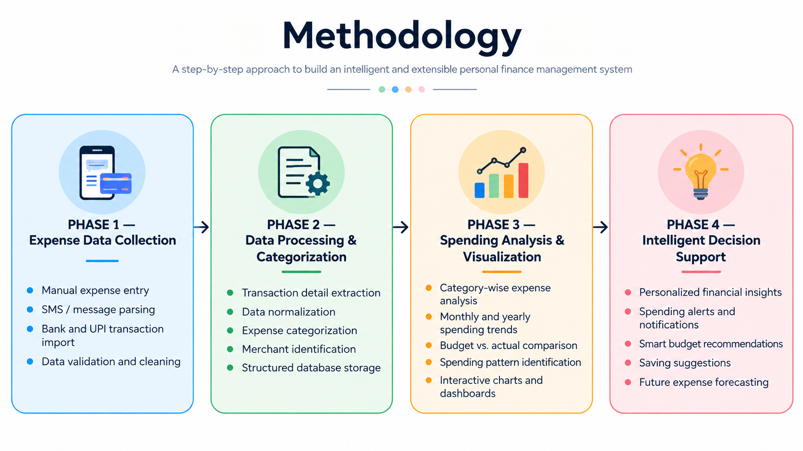

Slide 4
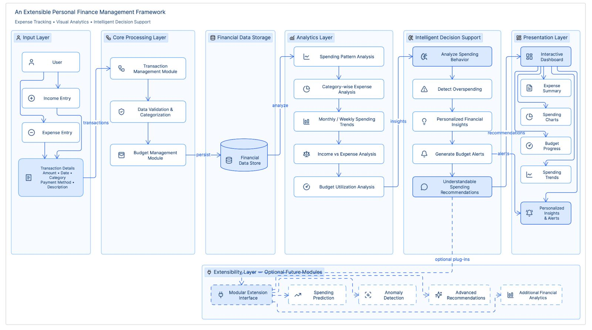
System Design

Slide 5
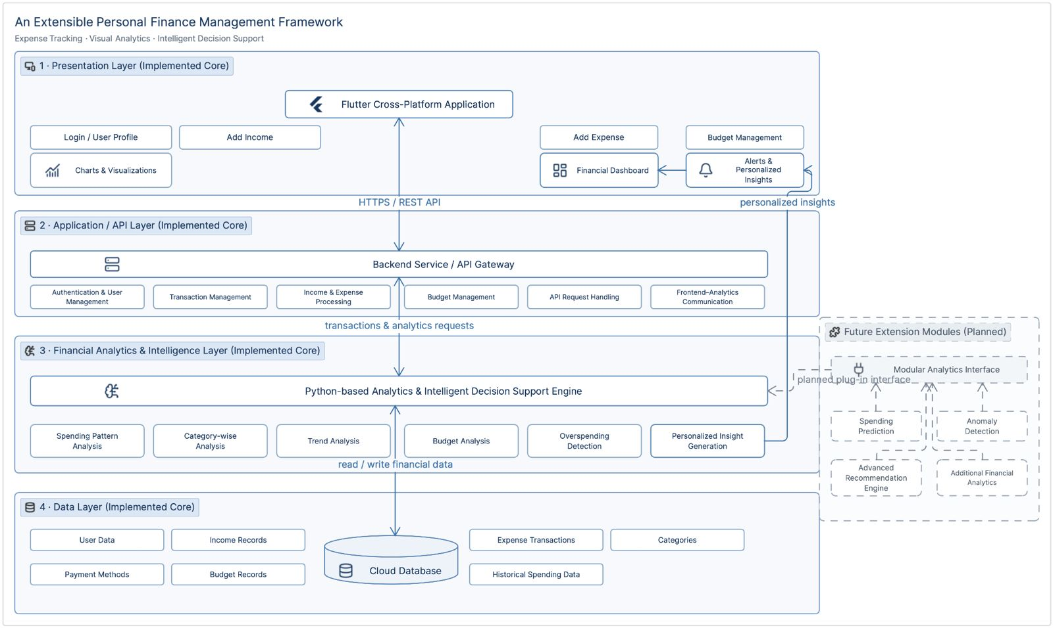
System Architecture

Slide 6
Use of Modern Tools and Technologies
Layer | Tools / Technologies | Purpose
Programming | Java, Dart | Develop backend logic and application functionality
Frontend | Flutter | Create a responsive and user-friendly mobile interface
Backend | Spring Boot | Develop backend services and REST APIs
Data Processing | Python, Pandas | Cleaning, transformation and feature processing
UI/UX Designing | Figma | Design user interfaces and prototype application screens
Message Parsing | Regex, NLP | Extract transaction details from financial messages
Database | MySQL | Store and manage user and transaction data
API Testing | Postman | Test and validate backend APIs
Visualization | Chart.js, Flutter Charts | Display spending patterns through graphs and charts
Development | VS Code, Android Studio | Version control and development

Slide 7
Experimental Setup
Component | CyberGuardians Plan | Details
Dataset | Sample financial transaction records | Sample financial transaction records
Data Sources | Manual entries + SMS/UPI messages | Manual entries, SMS, bank and UPI alerts
Feature Processing | Extraction + normalization | Data cleaning, extraction, normalization
Model Training | Categorize and organize expenses | Automated expense categorization
Data Integration | Integrate multi-source transactions | Unified transaction database
Analytics Engine | Analyze spending patterns | Spending pattern and trend analysis
Decision Support | Generate budget insights | Budget alerts and saving suggestions
Evaluation | Accuracy + usability testing | Accuracy, functionality, and usability testing
Environment | Documented and reproducible setup | Flutter, Spring Boot, Python, MySQL

Slide 8
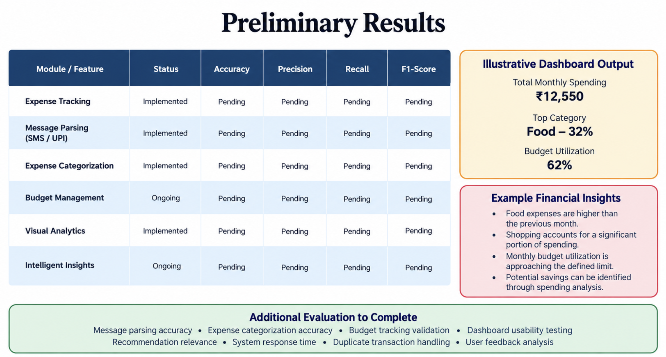

Slide 9
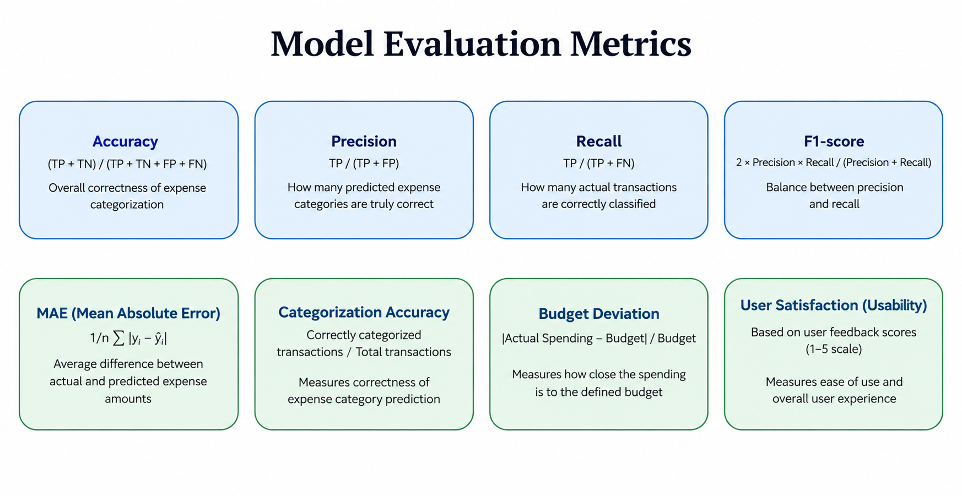

Slide 10
Published Model Evaluation
Model | Accuracy | FPR | FNR | F1-score
Naïve Bayes | 32.53% | 99.52% | 91.86% | 0.44
Decision Tree | 98.29% | 5.36% | 0.48% | 0.97
Random Forest | 99.24% | 2.13% | 0.31% | 0.98
AdaBoost | 98.06% | 5.26% | 1.23% | 0.96
Gradient Boosting | 98.06% | 6.58% | 0.37% | 0.96
Key observation:
The published study reports Random Forest with 99.24% accuracy, 2.13% FPR, 0.31% FNR and 0.98 F1-score on its evaluation setting.
These figures are published benchmark results, not CyberGuardians results. CyberGuardians must be evaluated on its own defined dataset and experimental protocol before any improvement is claimed.
Source: “Windows PE Malware Detection Using Ensemble Learning,” Informatics, 2021, 8(1), 10. Published Table 3.

Slide 11
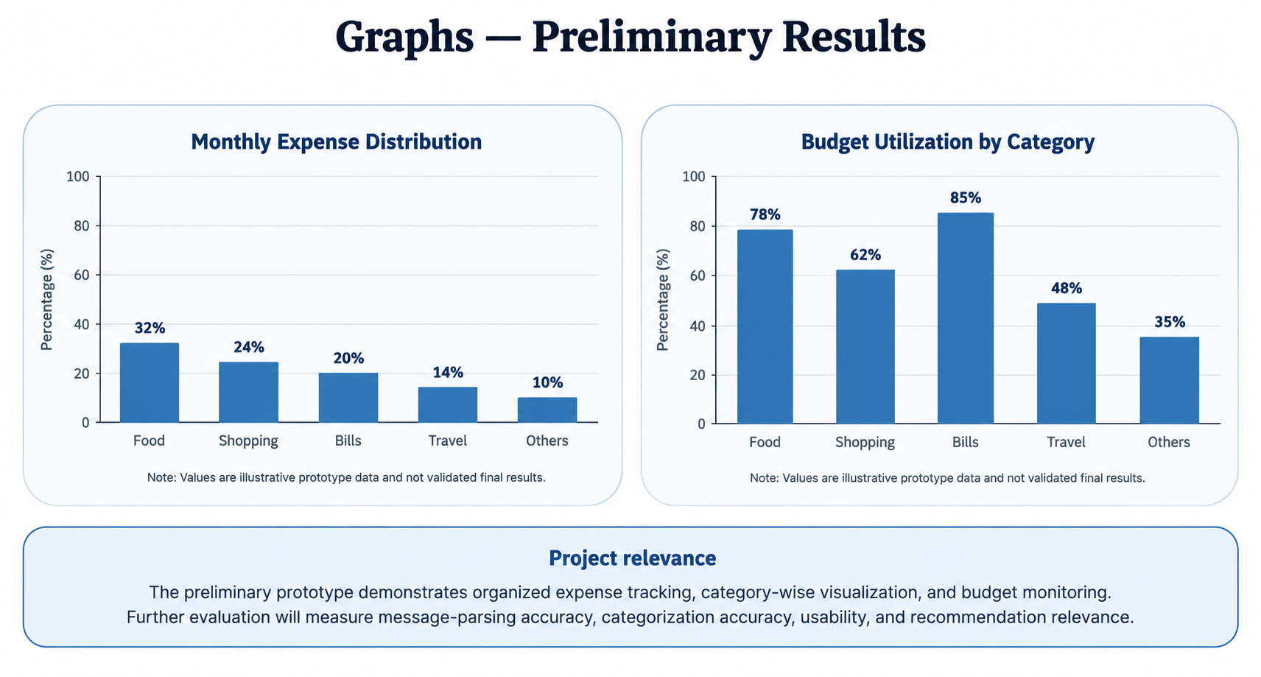

Slide 12
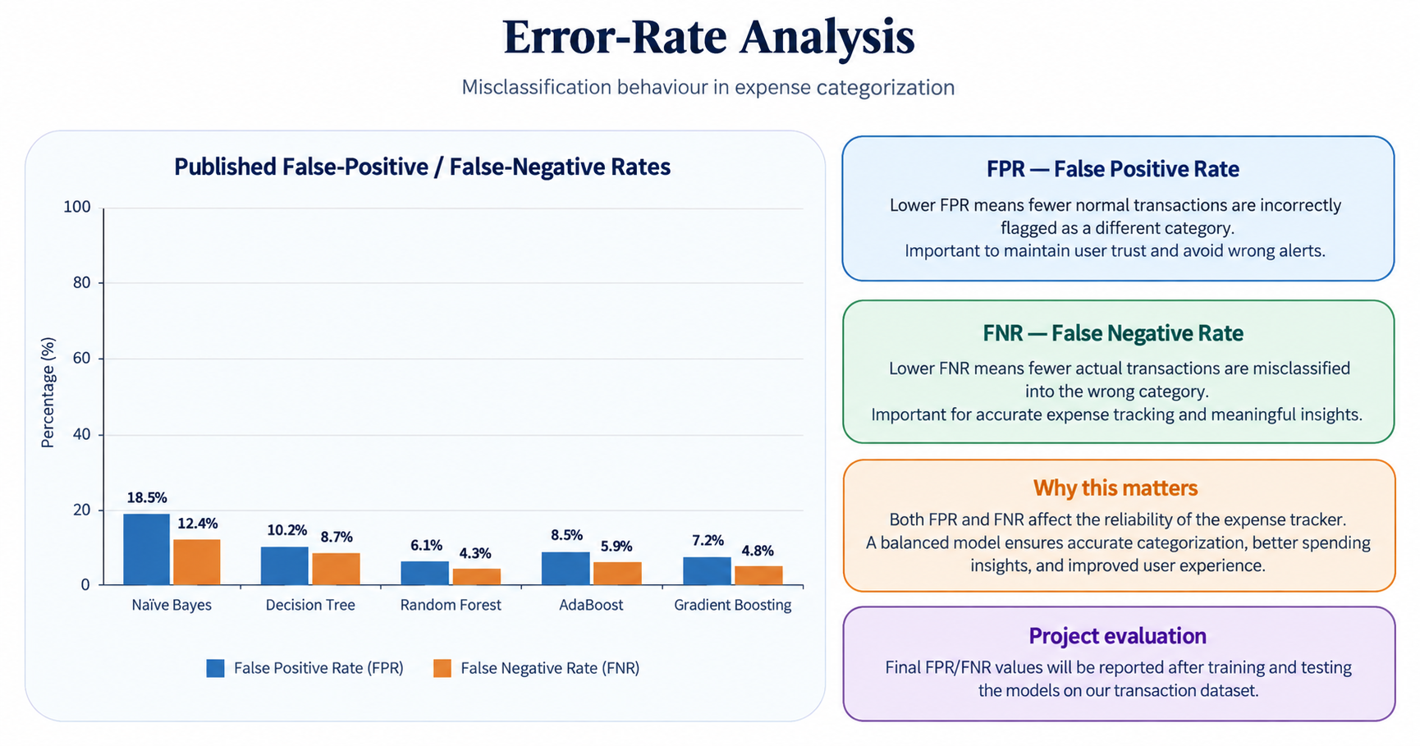

Slide 13
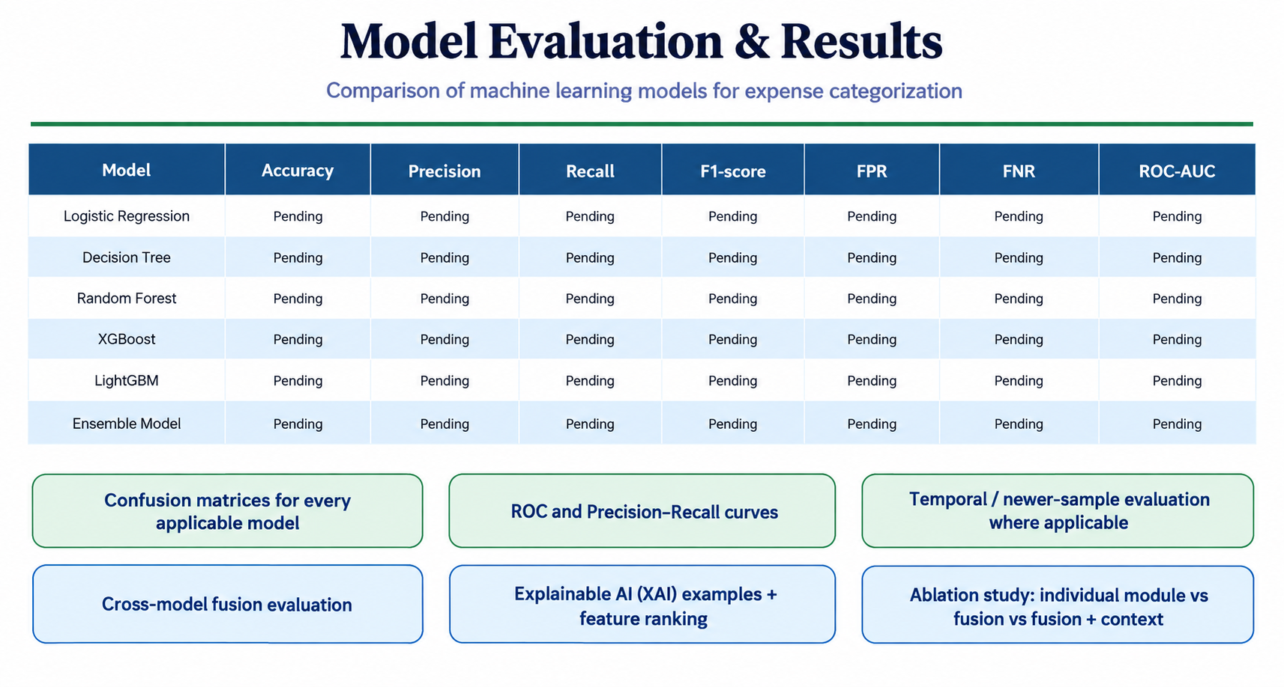

Slide 14
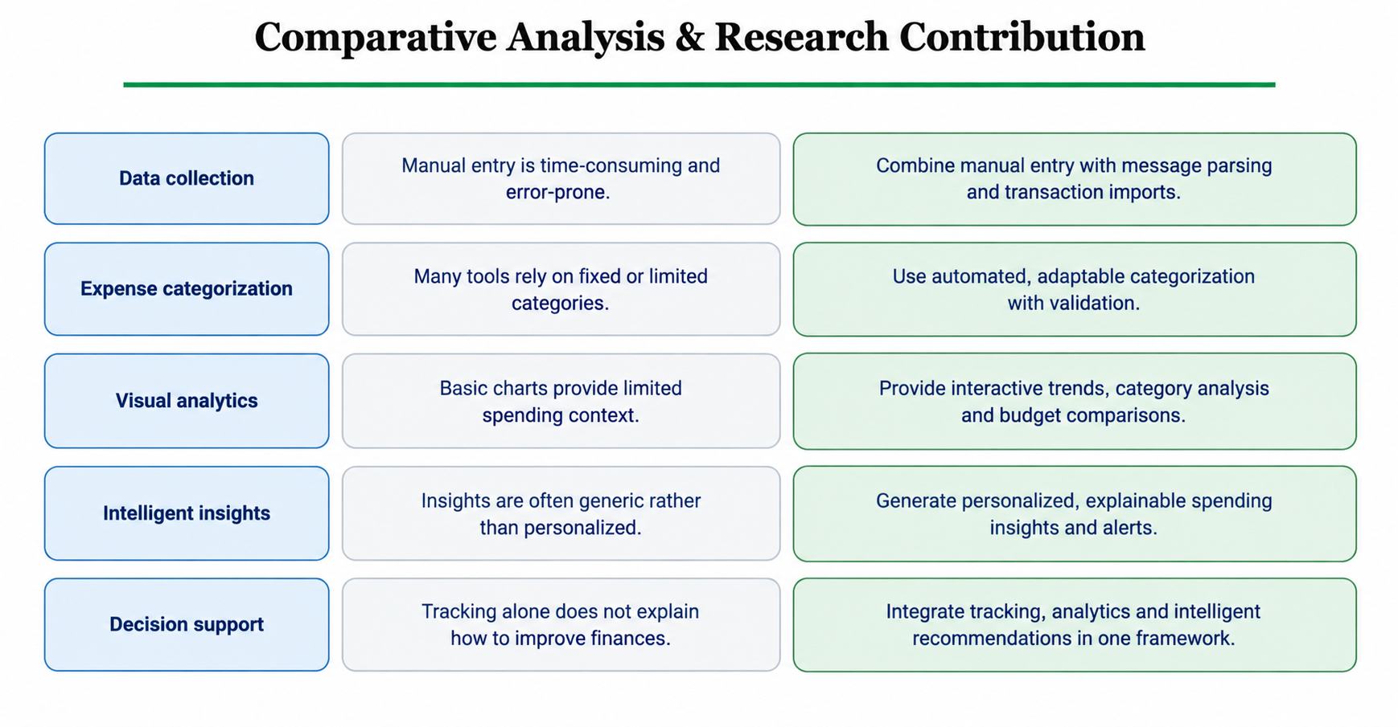

Slide 15
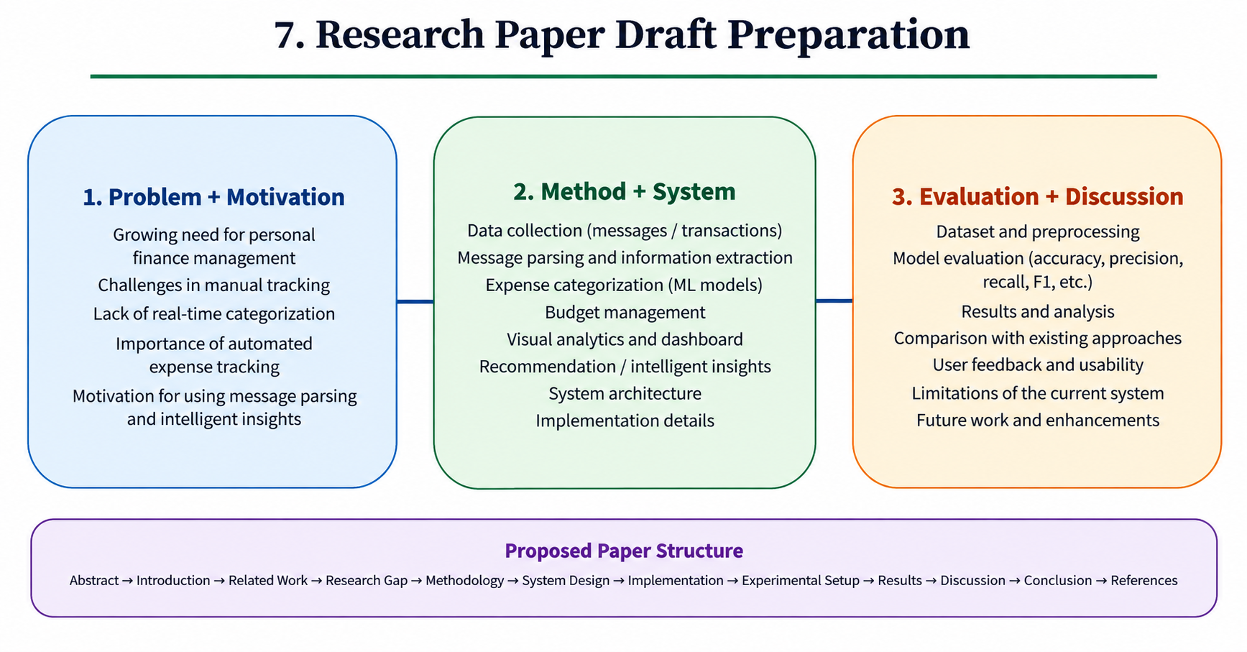

Slide 16
8. Reference Papers
[1] Vahidov & He (2009), Situated DSS for Personal Finance Management: Design and Evaluation | https://doi.org/10.1016/j.dss.2008.11.006
[2] Lu & Chang (2007), An Intelligent Agent-Assisted Decision Support System for Family Financial Planning | https://doi.org/10.1016/j.eswa.2006.05.020
[3] Lesner et al. (2019), Large Scale Personalized Categorization of Financial Transactions | https://doi.org/10.1609/aaai.v33i01.33019365
[4] Jadhav & Patil (2025), AI-ML Based Expense Categorization and Budgeting System for Personalized Financial Management | https://doi.org/10.52783/cana.v32.5266
[5] Nayak & Jayakumar (2024), An AI-Powered Mobile Application for Intelligent Personal Finance Management and Decision Support | https://www.ijrtte.com/paper-details-view.php?id=107
[6] Alhenshiri et al. (2026), An Intelligent System for Semantic Classification of Personal Expenses from Transaction Descriptions | https://doi.org/10.36602/ijeit.v14i2.609
[7] Amrendra et al. (2025), Smart Pocket: A Machine Learning-Based Expense Tracker and Spending Predictor | https://rsisinternational.org/journals/ijrias/view/smart-pocket-a-machine-learning-based-expense-tracker-and-spending-predictor
[8] Yang et al. (2026), A Deep Learning Framework for Automated Transaction Classification and Budget Prediction in Personal Financial Management | https://link.springer.com/article/10.1007/s44163-026-02025-1
[9] Ingale et al. (2026), Real-Time Expense Tracker with Smart Budget Recommendation System | https://doi.org/10.17148/IJARCCE.2026.153103
[10] Expense Radar: An AI-Driven Budget Management System (2025) | https://doi.org/10.1109/ICCA66035.2025.11430733

Slide 17
THANK YOU

